Slide 1
UNIT:2 Contents
Harmonics
Illumination – Lux, Lumens
Types of lighting, Efficacy
LED Lighting And types
Scope Of Energy conservation In Illumination

Slide 2
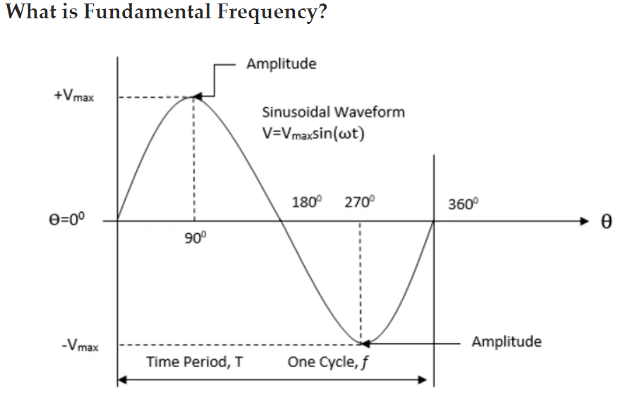
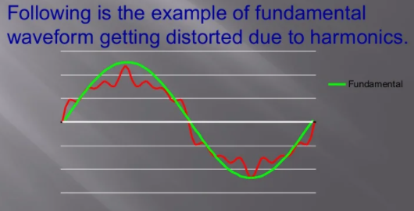
Harmonics
Unwanted higher frequency component that is an integer multiple of the fundamental frequency. Harmonics create a distortion in the fundamental waveform.
The distortion of fundamental sinusoidal waveform supplied by any source is the Harmonics in the electrical circuit.

Slide 3
Cause of Harmonics
Harmonics are caused by the load like:
Controlled Rectifiers
AC and DC variable Speed Drives
Solid State Heater Controls
Rectifier Transformers
Zero Switching Transformers
Linear Loads can cause harmonics during the starting.
Capacitors switching also causes harmonics
The root cause of harmonics is the non-linear current drawn by the load even after applying linear voltage waveform.

Slide 4
Need of Harmonics study & Correction
To prevent :
Premature failure of power factor improving capacitors.
Overheating of transformers
Overheating of source alternators
This causes increase in active losses
These are supplied from prime mover resulting in “ higher specific fuel oil consumption”.
Harmonics in power systems result in increased heating in the equipment and conductors and create a pulsating torque in the motors.
Harmonics cause increasing operating temperature and the iron losses (Hysteresis and Eddy current losses) in the AC motors and transformers because hysteresis loss is proportional to the frequency and eddy current loss is proportional to the square of the frequency.

Slide 5
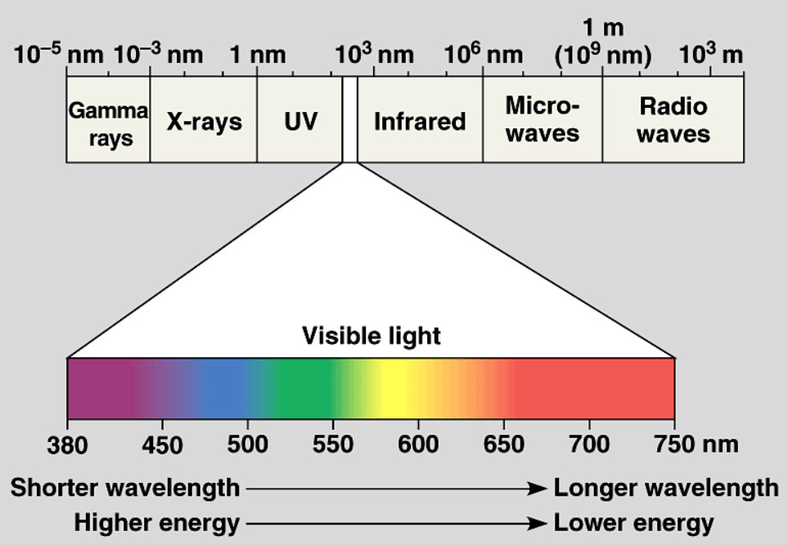
Illumination
What is Light?
The very small part of electromagnetic spectrum, sandwiched between ultravoilet and infrared radiation. The visible portion of electromagnetic spectrum extends from about (380-780) nm of wavelength.

Slide 6
1. Luminance
The measurement of the amount of light emitting, passing through or reflected from a surface from a solid angle.
It also indicates how much luminous intensity can be sensed by the human eye.
This means that luminance indicates the brightness of light emitted or reflected off a surface.
In the display industry, luminance is used to quantify the brightness of displays.
Candela (cd) is the unit of luminous intensity.
(SI) unit for luminance is candela/square meter (cd/m²)

Slide 7
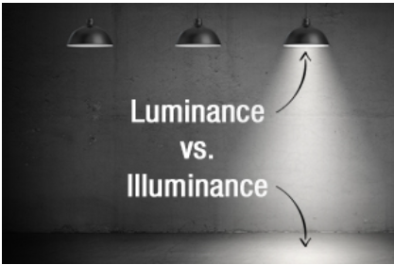
2. Illuminance
It describes the measurement of the amount of light falling on and spreading over a given surface area.
Illuminance also correlates with how humans perceive the brightness of an illuminated area.
As a result, most people use the terms illuminance and brightness interchangeably which leads to confusion, as brightness can also be used to describe luminance.
To clarify the difference, illuminance refers to intensity of light falling onto a surface, while brightness refers to the visual perceptions and physiological sensations of light.
Brightness is not a term used for quantitative purposes at all.
The SI unit for illuminance is lux (lx).

Slide 8
3. Luminous Flux- The light energy radiated out per second from the body in the form of luminoius light waves.
The rate of flow of energy is sort of power unit.
The unit of luminous flux is Lumen.
1 lumen = 0.0016 Watt
4. Lumen Hour- The quantity of light delivered in one hour by flux of one lumen.
5. Luminous Intensity- of a point source in any particular direction is given by luminous flux radiated out per unit solid angle in that direction. It is the solid angular flux density of a source in a specific direction.
Unit is Candela (cd) or, lumen/steradian (lm/sr).

Slide 9
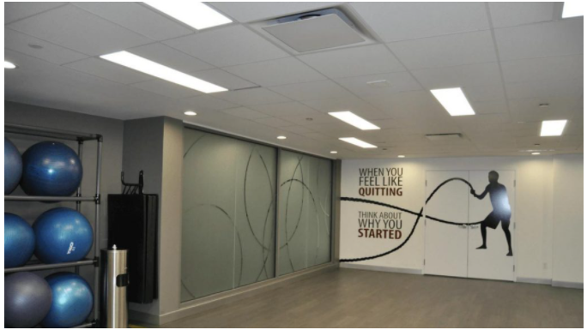
Types of Lighting
1. Ambient lighting
2. Task lighting
3. Accent lighting
1. Ambient Lighting-
1(a). Ambient Indoor Lighting- General or ambient lighting is intended to light up a room in its entirety. It provides a uniform level of illumination throughout the space independently of other lighting sources.

Slide 10
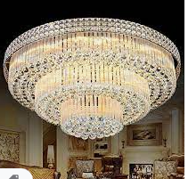
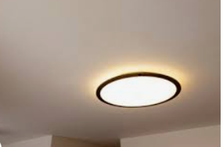
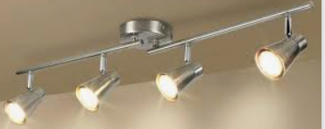
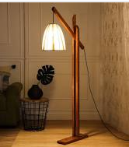
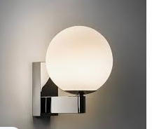
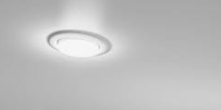
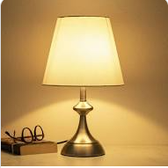
Continued...
Types of fixtures:
Track light
Chandelier
Ceiling mounted fixtures
Floor lamp
Wall-mounted fixture
Traditional recessed fixtures and / or LED downlights
Table lamp

Slide 11
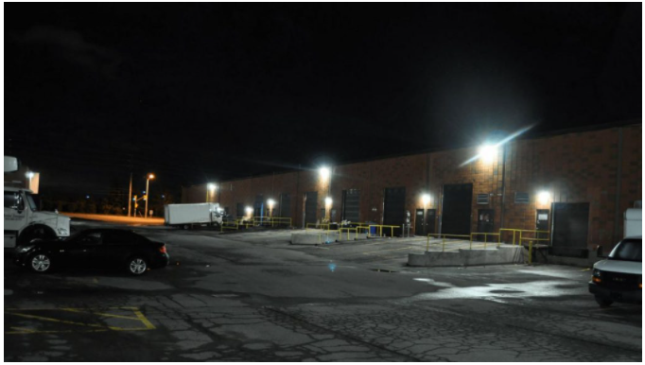
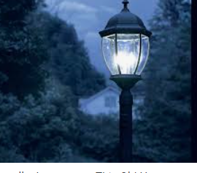
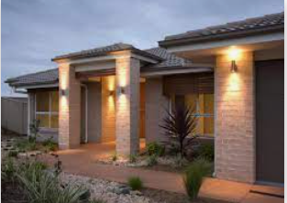
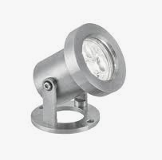
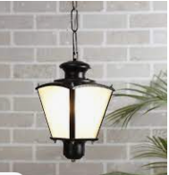
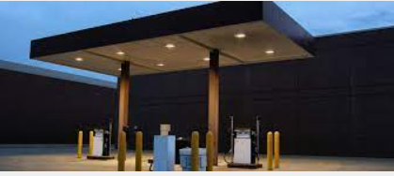
Continued...
1(b). Ambient Outdoor Lighting- Outdoor lighting is usually installed in order to ensure visibility and increase security around a building. It is also recommended to light up the exterior of the building, entrances and stairs to reduce and perhaps eliminate the risk of injury that can occur when entering and leaving the building.
Types of fixtures:
outdoor Hanging fixture
Garage and canopy lighting
Spotlight
Post lantern
Wall lighting

Slide 12
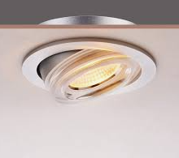
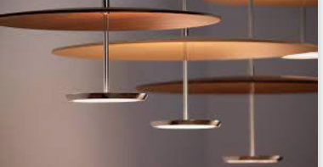
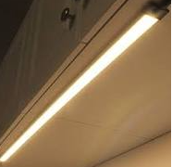
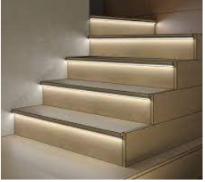
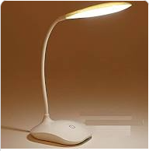
Continued...
2. Task Lighting- Task lighting illuminates the tasks a person carries out in a given space such as reading, cooking, computer work. A brighter light is required in a smaller focal point of the room for these sorts of tasks. For a more pleasant illumination, it is often best to avoid harsh lights or lighting that casts troublesome shadows. It is also practical to install a single switch for focal lighting, independent from the room’s overall lighting switch.
Types of Fixtures:
Directional gimbal recessed fixture or downlight
Pendant lighting
Slim line bar and
undercabinet
Tape and extrusion light
Portable or desk lamp

Slide 13
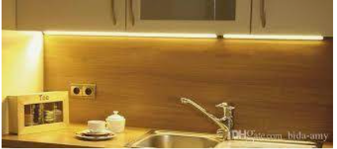
Continued...
3. Accent Lighting- Accent lighting is used mainly to focus on a specific point of interest or to achieve a desired effect. This type of lighting gives the impression of a larger room. It is more frequently used to highlight an architectural feature, a plant (in outdoor layout), a sculpture, or a collection of objects.
As a general rule, effective accent lighting requires the installation of three times more light on the focal point than ambient lighting generally provides.
Type of Fixtures:
Track light
Slim line bar and undercabinet
Directional gimbal recessed fixture or downlight
Tape and extrusion light
Wall-mounted fixture

Slide 14
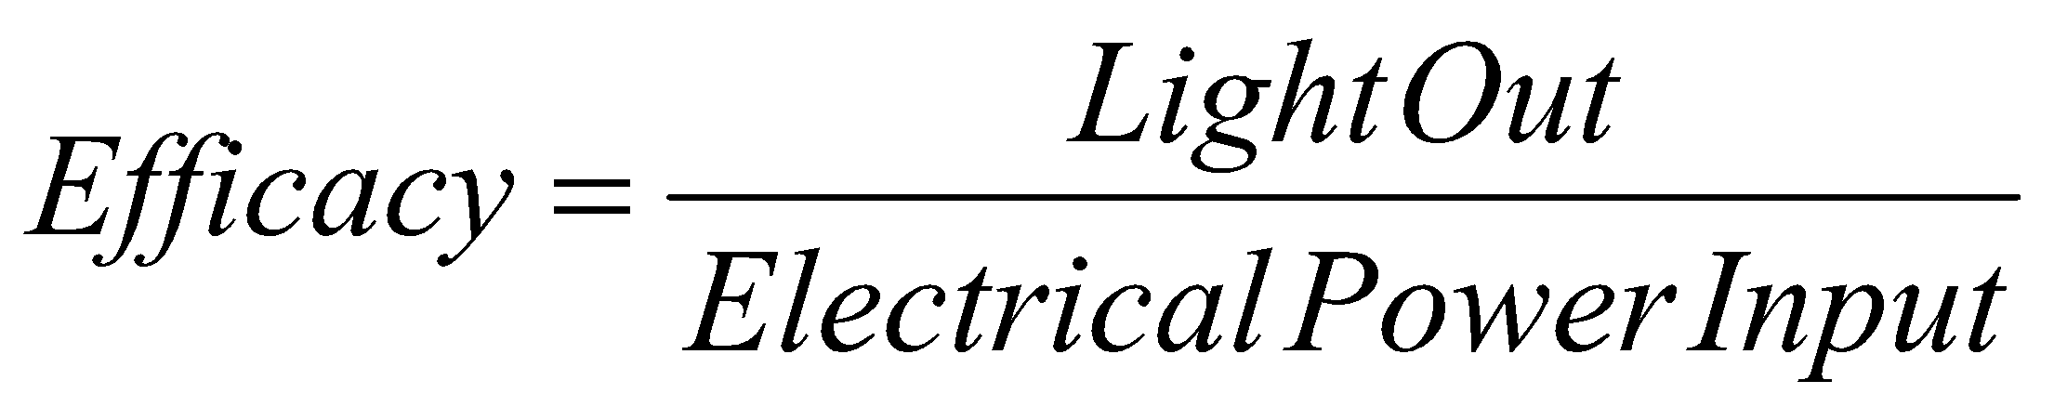
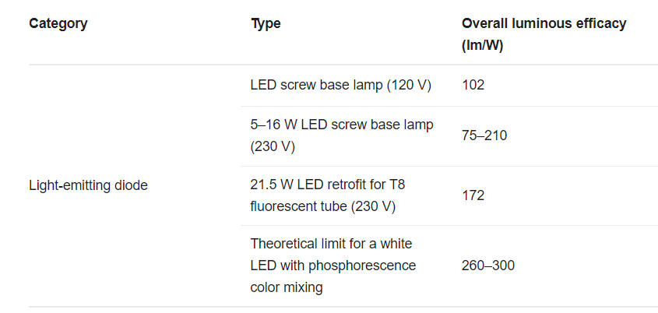
Efficacy
We know, For a motor, efficiency = (Power Output / Power Input)*100
Similarly, in light,
Unit- Lumen/Watt (Lm/W)
Example, Efficacy = 5000 Lm/ 80 W = 62.5 Lm/W
The luminous efficacy of a typical CFL is 50–70 lumens per watt (lm/W) and that of a typical incandescent lamp is 10–17 lm/W.

Slide 15
LEDs
Common Applications-
Camera Flashlights
TV
LED displays in smartphones
Lighting-Houses, Offices etc.
Street lights
Traffic signals
Display boards (Railways etc.)
Advantages:-
Lighting - More energy efficient than conventional bulbs
Lifespan is more than the conventional bulbs
Fast switching
Small size
better controllability (brightness of LED can be easily controlled)
maintain a cold temperature while traditional lights generate heat and excessive heat generation

Slide 16
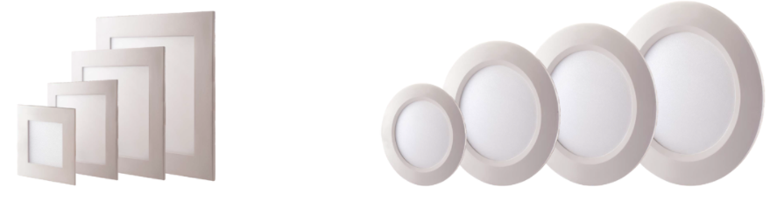
Types of LED lights
1. LED bulbs- The LED bulbs are energy-efficient and environment-friendly. The LED bulbs provide flicker-free operations and provide minimum glare. Also, LEDs bulbs can be dimmed with the help of a dimmer switch to change the ambience as per the changing mood. LED bulbs are available in different colours and can be used as per the requirement and choice to make the look more joyful.
2. LED panel lights- LED panel lights are thin architecture masterpiece. These LED panel lights are also energy-efficient, environment-friendly, produces less heat and maintenance-free. The durability of LED panel light is amazing and can serve the purpose for several years. During the lifespan, the light of the LED remains constant and never dims and gives a better output than CFLs. You can get LED panel light in warm white, cool white and cool daylight variants.

Slide 17
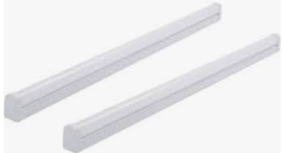
Continued...
3) LED tube lights- LED tube lights are also energy-efficient, environment-friendly, produces less heat, maintenance-free and durable as compared to fluorescent tube lights. Also, LED tube lights provide uniform lighting and offer significant savings on account of power consumption.

Slide 18
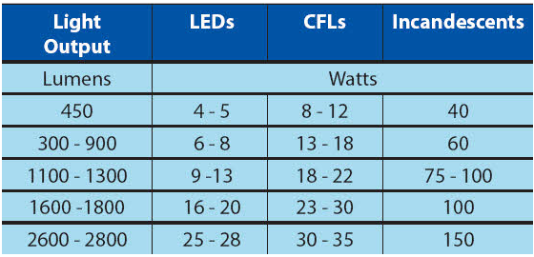
Scope of energy conservation in Illumination
1. Optimization of Industrial/ Domestic Lighting (Lux Optimization)
2. Optimal Use of Natural Light
3. Lighting Control in Industries- Lights can be shut off during non-working hours automatically.
4. Use of LED Lamps
5. Periodic survey and adequate maintenance programs

